Slide 1
If you run into any issues, post an issue on Github here
https://github.com/MakerMeets/ttn/issues

Slide 2
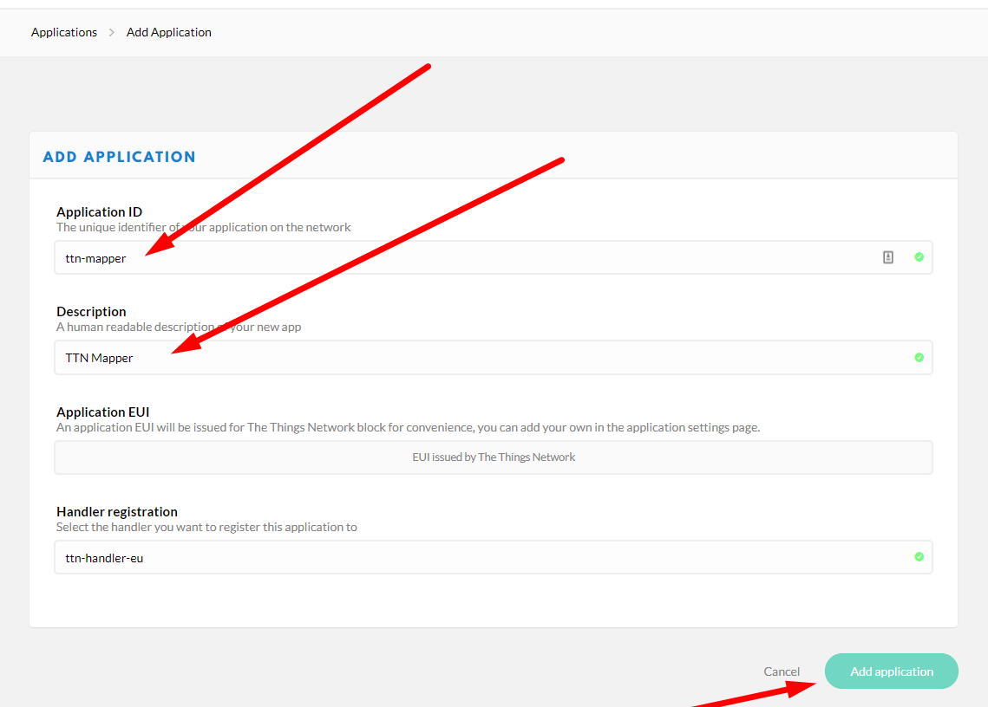

Create Application in TTN Console

Slide 3
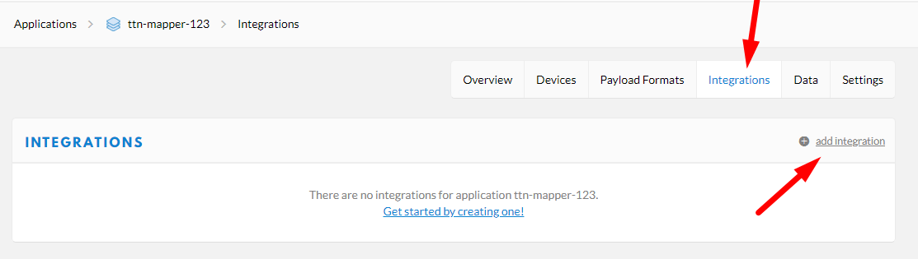
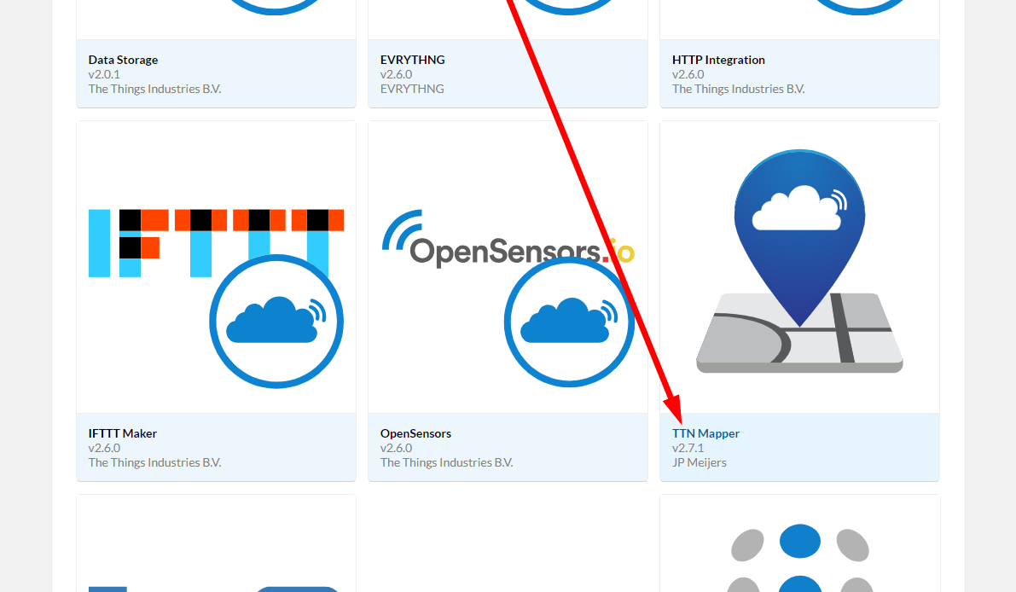
Add the TTN Mapper Integration

Slide 4
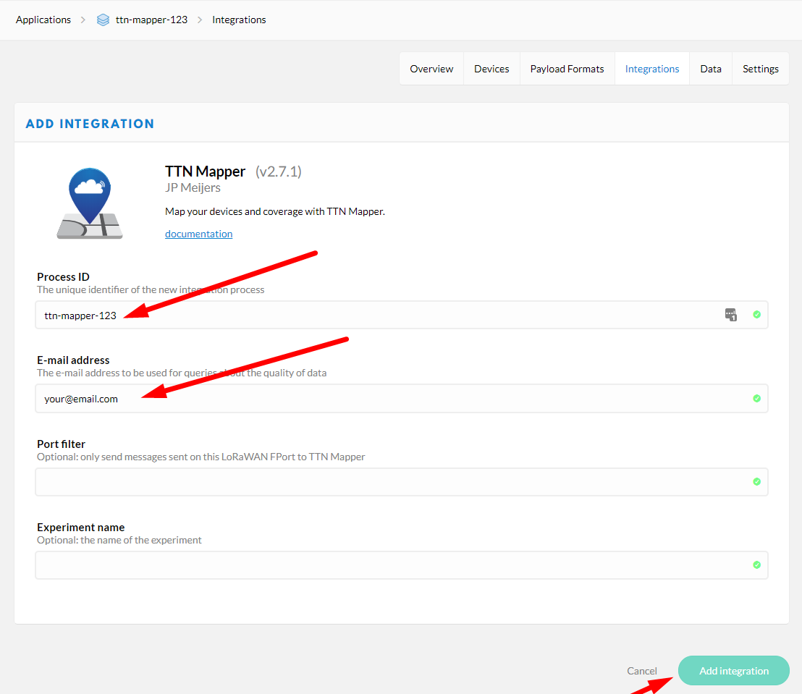
Configure TTN Mapper

Slide 5
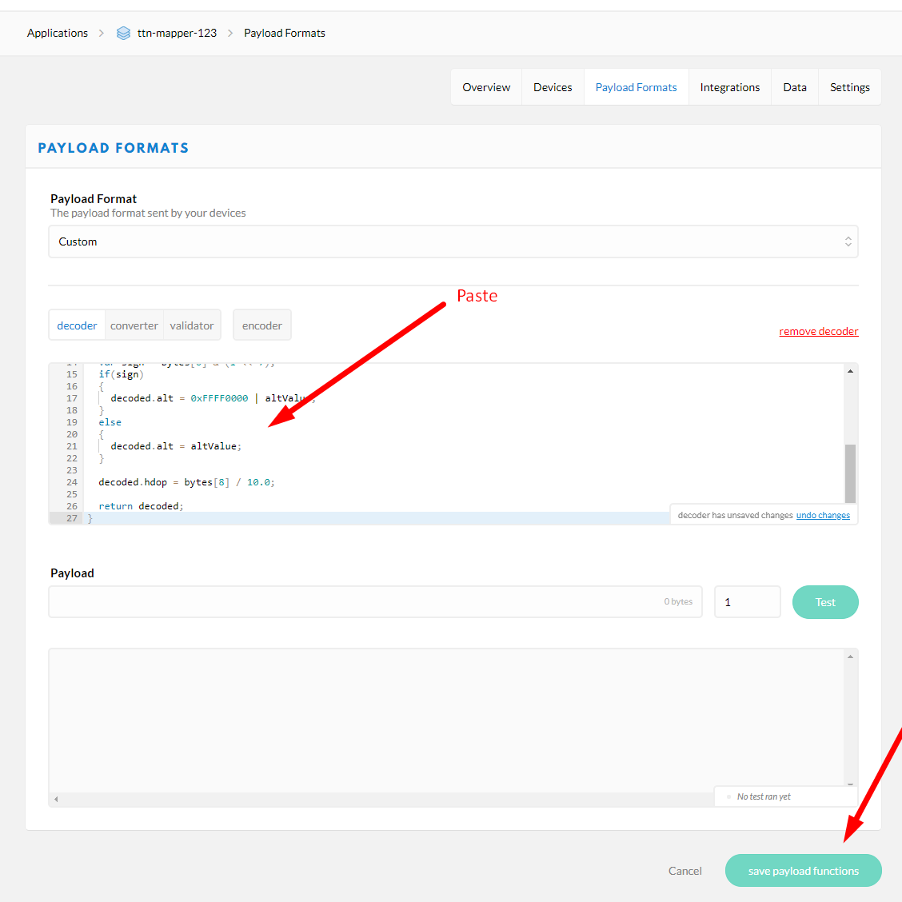
Update the Encoder

Slide 6
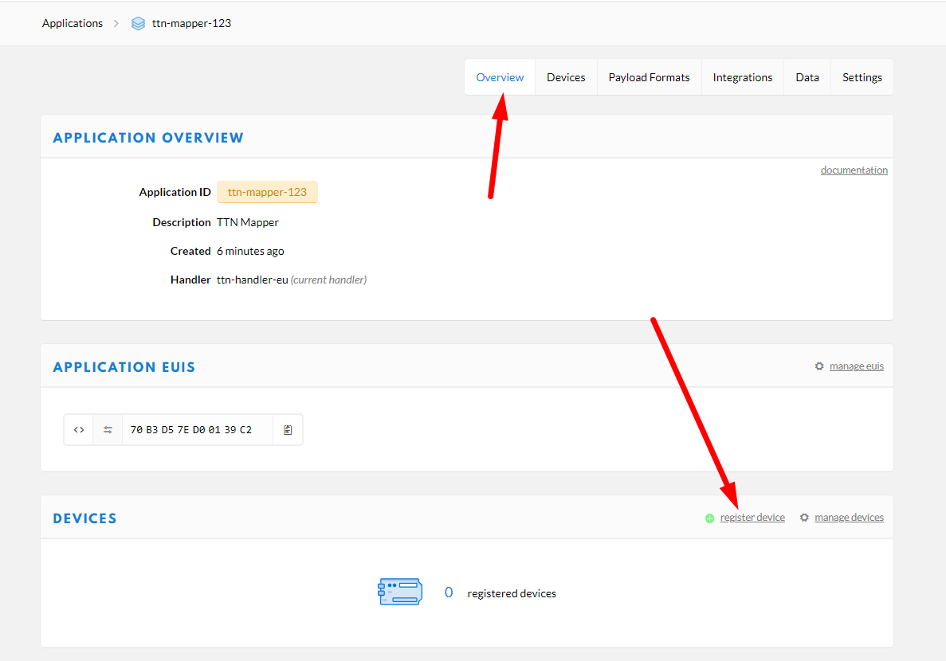
Register a Device

Slide 7
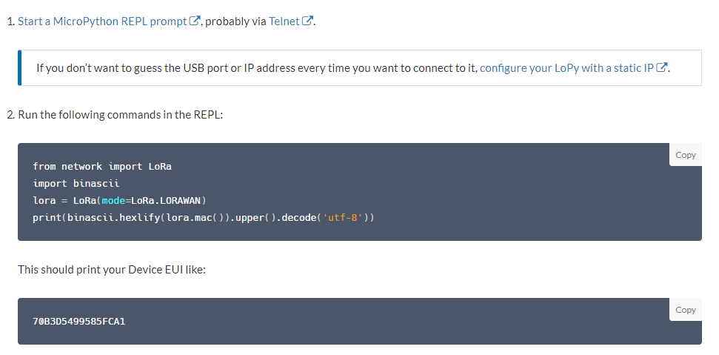
Get the Device EUI
https://www.thethingsnetwork.org/docs/devices/lopy/usage.html

Slide 8
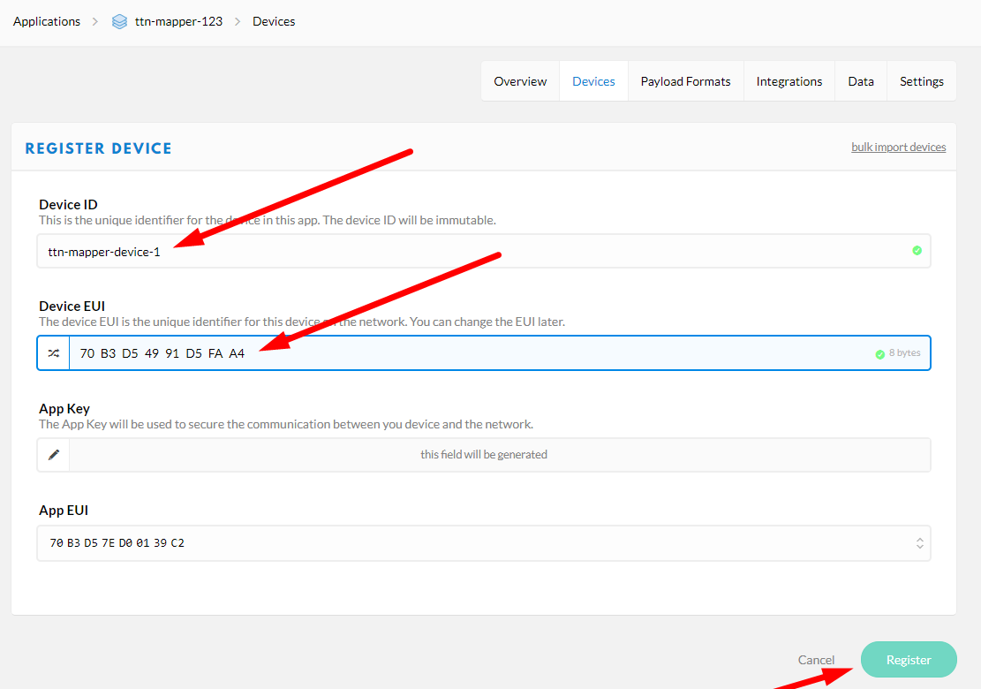
Complete Device Registration

Slide 9
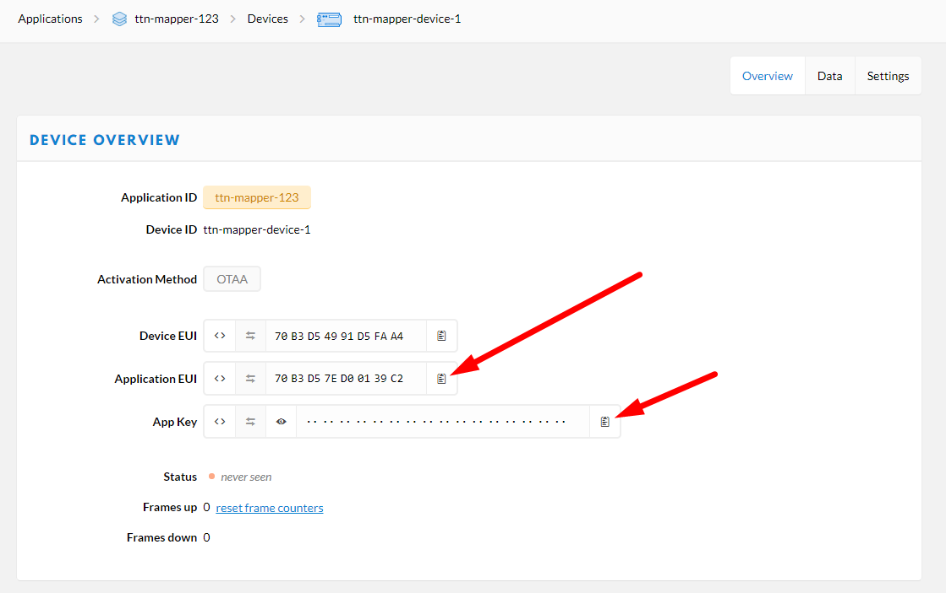
Get App Settings

Slide 10
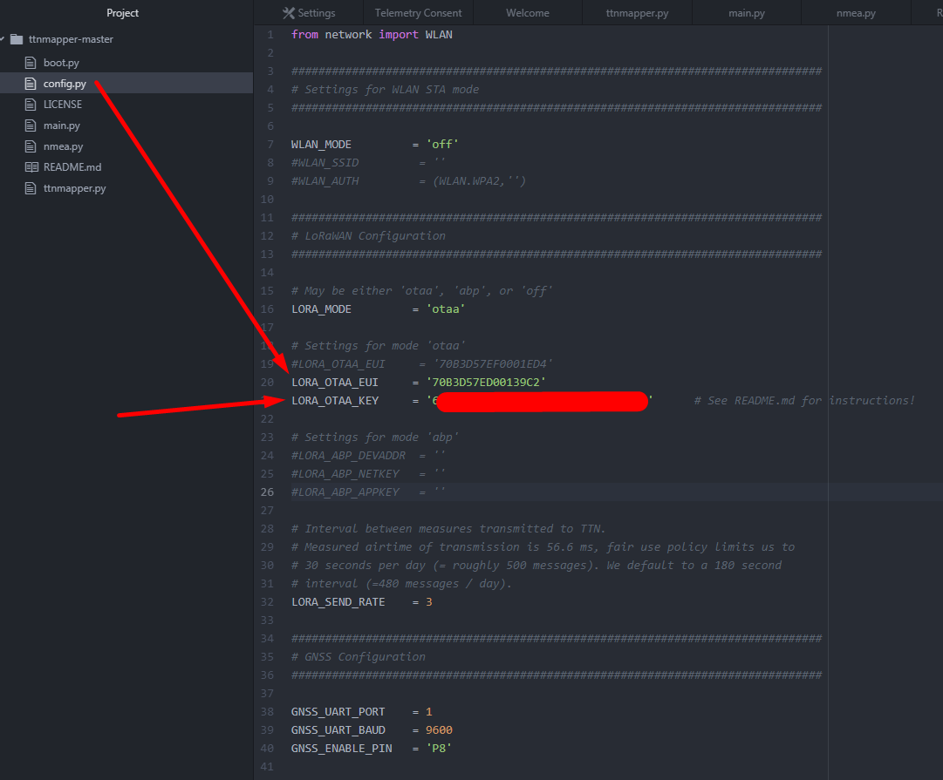
Update config.py

Slide 11
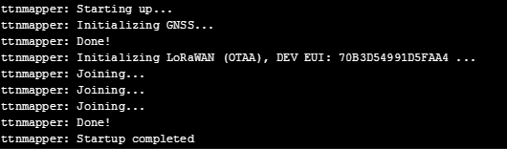
Monitor REPL

Slide 12
Get TTN Mapper Phone App
* Not needed if a GPS is used, although is handy for “observations”
Use this for generating a QR code https://www.qr-code-generator.com/
Example format (modify to suit your own settings)
http://asia-se.thethings.network:ttn-mapper-123:ttn-mapper-device-1:ttn-account-v2.oq1wWxXXX

Slide 13
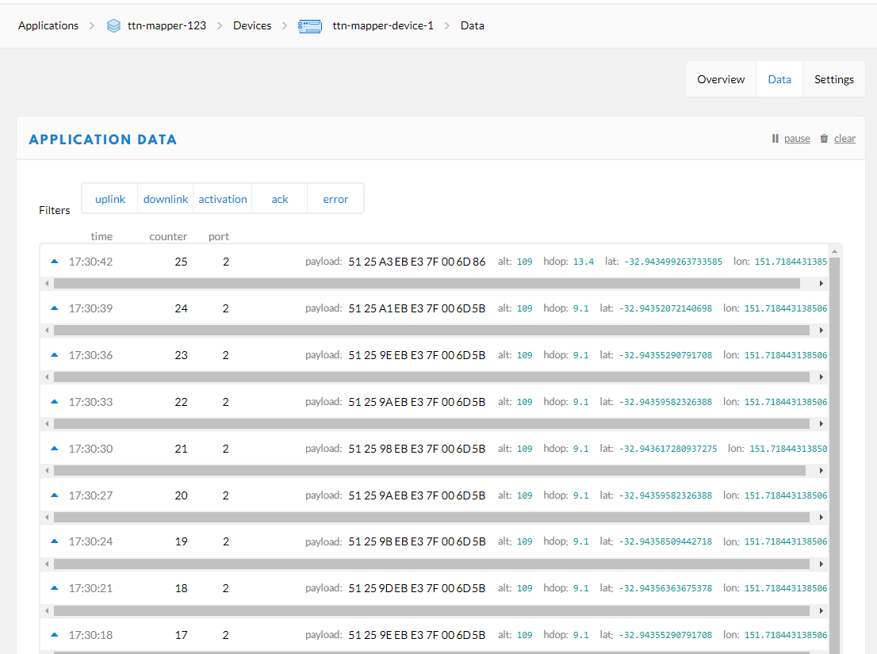
Monitor TTN Console (when there is GPS reception)

Slide 14
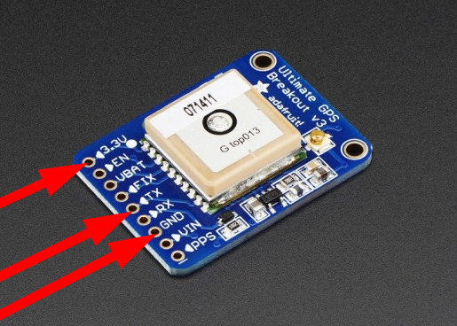
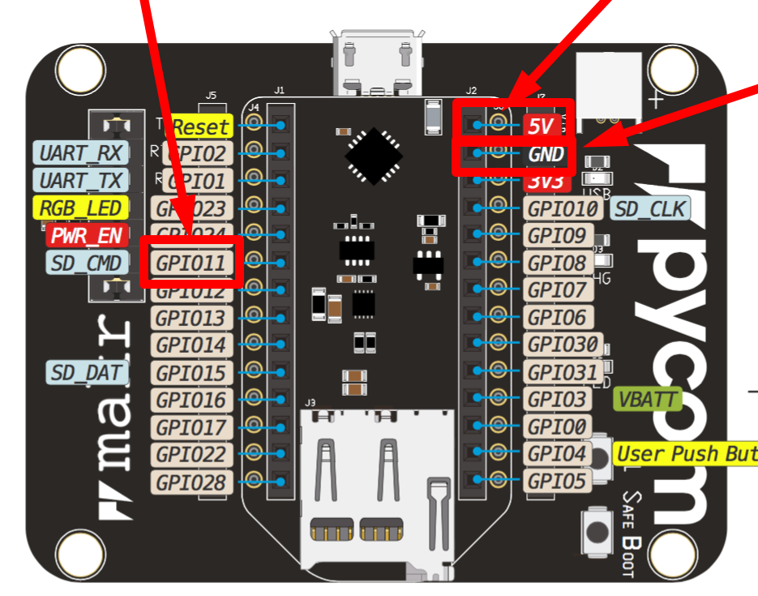
Hardware Hookup

Slide 15
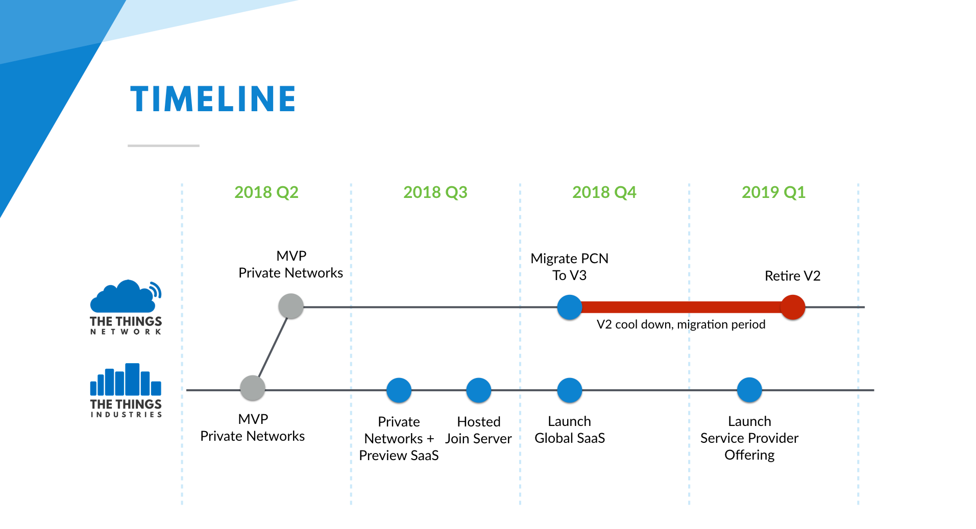

Slide 16
